Slide 1

REPORT
CATALOG
DATE
ANALYSIS
SUMMARY
Game AI created based on Unity reinforcement learning tool MLAgents
RESUME
Reporters: Alan and Harris
2024-06-30

Slide 2



CONTENTS
REPORT
What is this
Machine Learning
Unity
Future Work

Slide 3

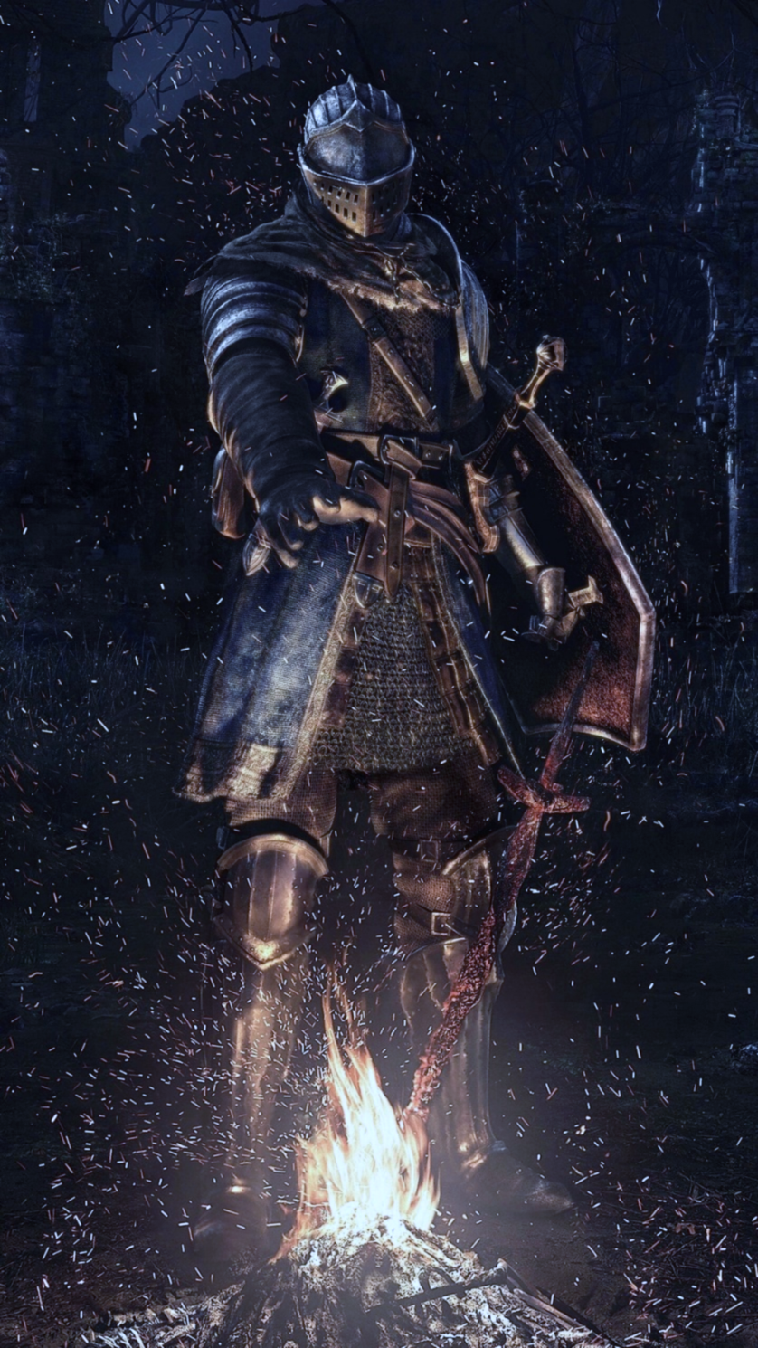
REPORT
01
What is this？

Slide 4
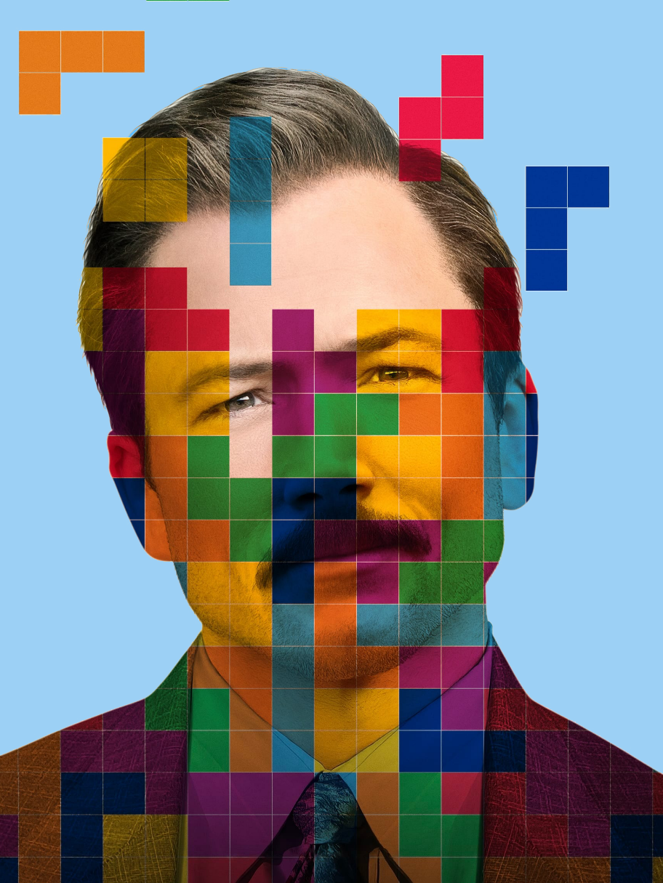
What
01
LAST TRY
The project we were planning to do failed due to interface failure on baiduAI's side. So we were going to make a new project. Since I have a foundation in machine learning and Harris has a foundation in Unity, we are going to do a machine learning plus Unity project
02
New
So we are going to build a scenario and try to train an AI to play the game, and in the future we would like to train more such AIs in a generalized way.The name of our project is Game AI.
Our project is called Game AI. Game AI was created based on Unity reinforcement learning tool MLAgents, and its training environment consists of Anaconda, pytorch, and MLAgents plus Unity.
03
GAME AI
Our highlights are the use of ML-Agents as well as Unity effects. The Unity Machine Learning Agents Toolkit (ML-Agents) is an open source project that makes games and simulations an environment for training intelligent agents.

Slide 5
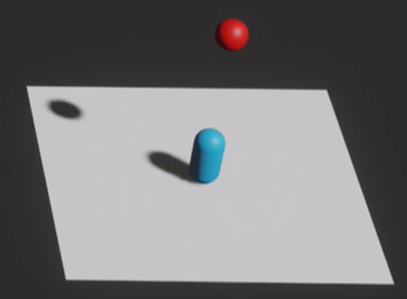
DEMO

Slide 6
REPORT
02
Machine Learning

Slide 7


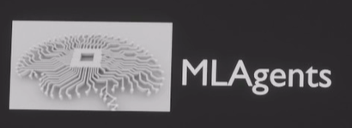








OnEpisodeBegin()
Heuristic()
OnActionReceived()
CollectObservations()

Slide 8
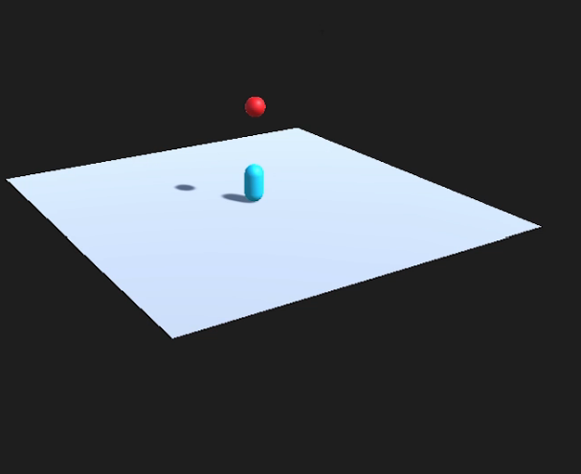
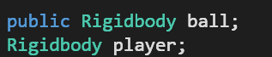
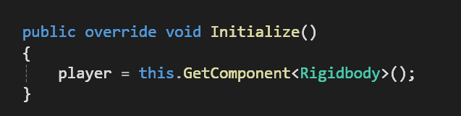

Slide 9
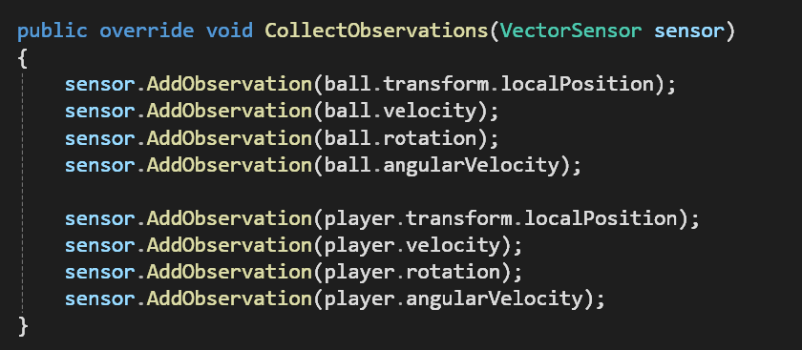
Determines what information about the game environment is visible to the ML-Agent.

Slide 10
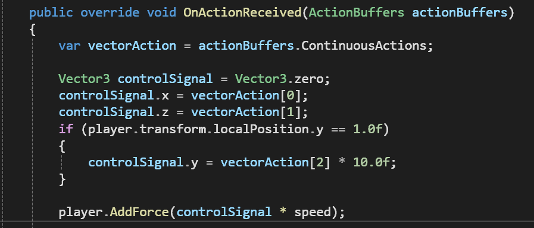

Slide 11
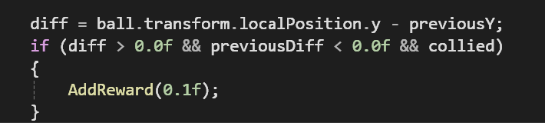
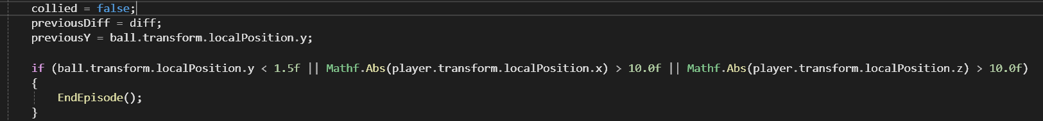

Slide 12
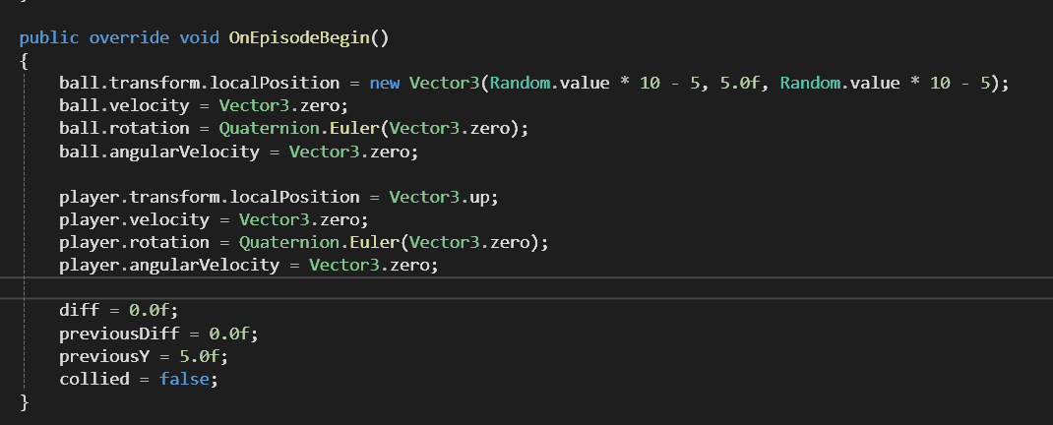

Slide 13
REPORT
03
Unity

Slide 14
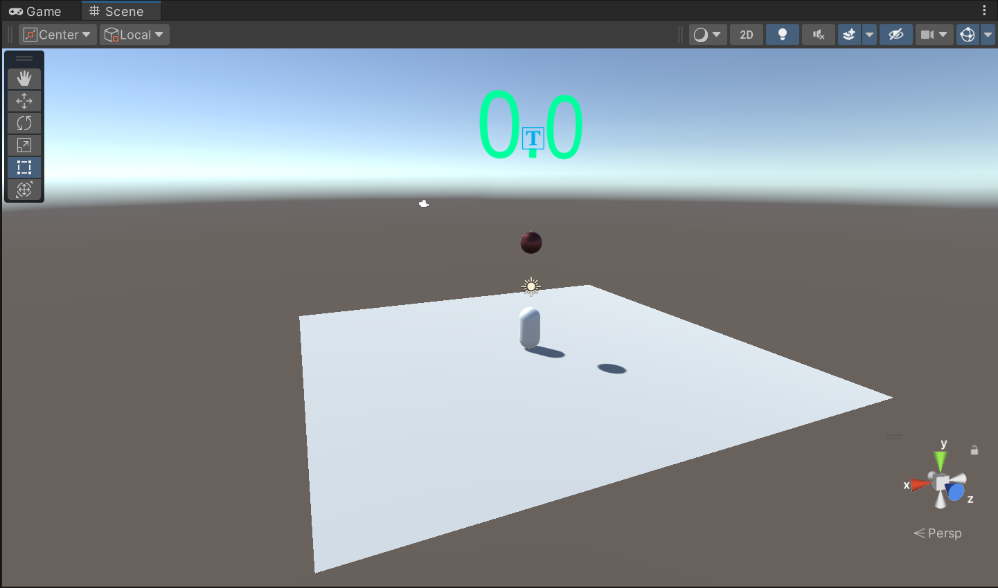
Main Objective:
Create a functionalAI NPC using the model
A simple scene with a capsule as the player, and a ball for the player to catch and a score board.

Slide 15
REPORT
04
Future Work

Slide 16

We want to
Improve the gameplay
We will try to design and add more game mechanics to improve the game play.
Improve the art
We will design the art style of the game to make it more special.
Create 3D assets
We will try to create better 3D assets

Slide 17
REPORT
CATALOG
DATE
ANALYSIS
SUMMARY
THANKS
RESUME

